Slide 1
Computational Guided Inquiry: Investigating Sea Level Rise Impacts in Tacoma, WA
Prepared by Lea Fortmann
Department of Economics
University of Puget Sound
Updated June 2019
Acknowledgements: This project was funded by NSF award #1712282 by the Division of Undergraduate Education and Office of Polar Programs

Slide 2
Module Overview and Learning Objectives
In the following sections you will learn some decision-making tools that incorporate risk and uncertainty for estimating the damage costs of sea level rise and flooding in your region. To conduct this analysis you will gather data on home property values and flood probabilities and apply them to a decision-making framework using economic modeling. By the end of the module you will formulate a policy recommendation for how best to adapt to climate change and sea level rise in your region.
Module Outline
Introduction
Part 1: Calculating Marginal Damages from Flooding and SLR
Part 2: Graphing Marginal Damage Curves in Excel
Part 3: Making Decision Given Uncertainty
Learning Objectives:
Increase climate literacy by connecting sea level rise due to ice melt in the Arctic and Antarctic to local regional impacts.
Learn tools to apply to decision-making given uncertainty in sea level rise and flooding.
Gain computational skills through calculating and graphing marginal damage curves in Excel.

Slide 3
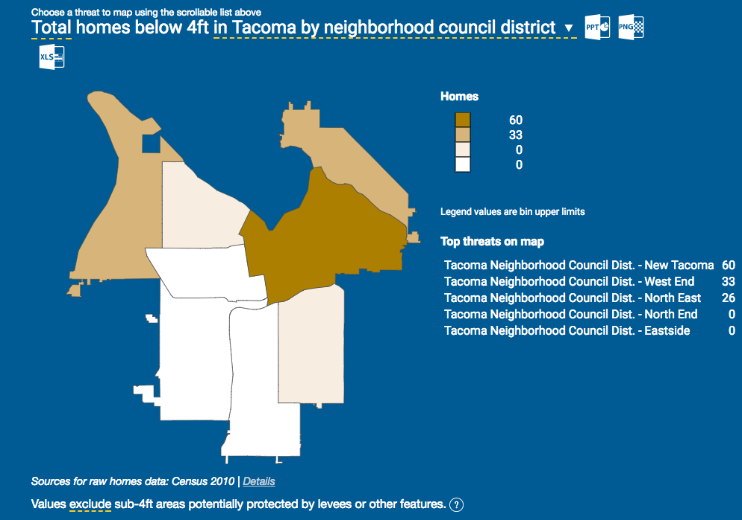
Part I: Estimating Home Values in Flood Prone Areas
One way to estimate the local impact of sea level rise due to Arctic ice melt is to look at the damages associated with higher flood levels. To start, we need to get an estimate of the total property damage that would occur at each level of flooding. To do this, you will use housing values in your local region that are most exposed to flooding.
To get housing values, go to the ArcGIS website here to find median home values in the U.S. for the year 2017.
Type your location of interest into the search bar at the top left of the screen then use the ‘+’ and ‘-’ buttons in the upper left corner to zoom in and out of the area.
Click on a block to see the median home price in that block group for 2017.
Now look at the Climate Central Risk Finder website for your region, (Tacoma, WA shown here) and scroll down to see what areas are most at risk due to flooding. Note: be sure to click on ’Buildings’ and then ‘Homes’ under the ‘What is at Risk?’ section to see the correct map.
Compare these two maps and decide on a median home price to use for the analysis.
Source: ESRI ArcGIS
Pause for Analysis: Discuss with a partner or in a small group why you chose that home price for this analysis.
Source: Climate Central Risk Finder

Slide 4
Part I: Calculating the Marginal Damage Cost of Flooding
Open your Excel spreadsheet and look at Table 1 on the ‘MD Table’ tab to see the total number of homes that will be exposed at each level of flooding in your region*.
Use the price you determined in the previous slide and double click on cell E3. Type the value into your Excel spreadsheet and hit ‘enter’.
Notice Columns C and D populate with the total property damages at each flood level, which is calculated by multiplying the number of houses exposed (Column B) by the median home value you just selected to get the total damages.
*Housing data displayed here is sourced from: Climate Central (2014). Sea level rise and coastal flood exposure in Tacoma, WA, in Surging Seas Risk Finder. Retrieved from ssrf.climatecentral.org/#p=L&state=Washington&location=WA_Town_5370000

Slide 5
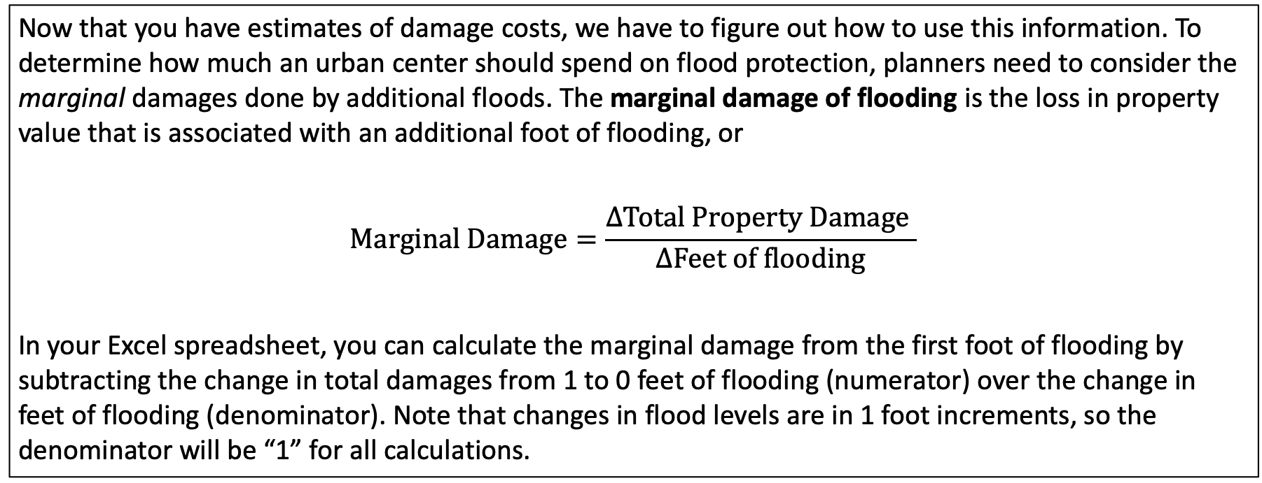
Part I: Calculating Marginal Damage Costs from Flooding
Now that you have estimates of damage costs, we have to figure out how to use this information. To determine how much an urban center should spend on flood protection, planners need to consider the marginal damages done by additional floods. The marginal damage of flooding is the loss in property value that is associated with an additional foot of flooding, or
$$Marginal Damage=\frac{∆Total Property Damage }{∆Feet of flooding}$$
In your Excel spreadsheet, you can calculate the marginal damage from the first foot of flooding by subtracting the change in total damages from 1 to 0 feet of flooding (numerator) over the change in feet of flooding (denominator). Note that changes in flood levels are in 1 foot increments, so the denominator will be “1” for all calculations.

Slide 6
Part I: Calculating Marginal Damage Costs from Flooding
1. To subtract the total damages given 1ft of flooding from damages with 0ft of flooding, type the formula ‘=E11-E10’ into cell E10, under the Marginal Damages column then hit ‘enter’.
Note: you can also click on the cell to fill in the cell reference (e.g. D10) instead of typing it.
2. Click on the cell to show the border, then click on the square in the lower right corner and drag it down to the last cell in the column to copy the formula into these cells.
Pause for Analysis: In a group or with a partner, discuss what the value in cell E16 in Table 1 represents in your Excel spreadsheet.

Slide 7
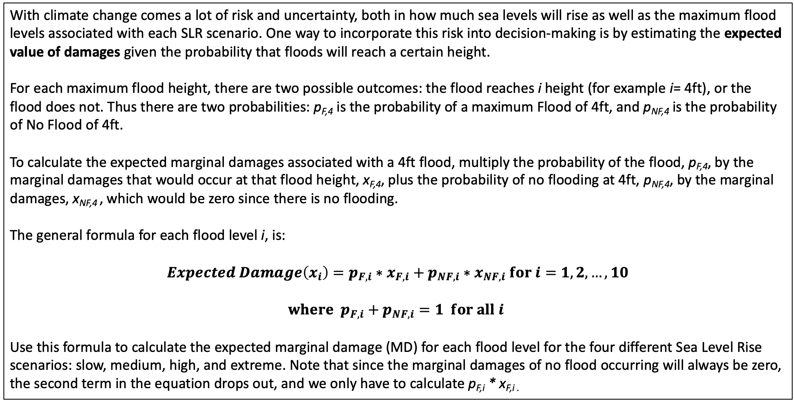
Part 1: Calculating Expected Damages from Flooding
With climate change comes a lot of risk and uncertainty, both in how much sea levels will rise as well as the maximum flood levels associated with each SLR scenario. One way to incorporate this risk into decision-making is by estimating the expected value of damages given the probability that floods will reach a certain height.
For each maximum flood height, there are two possible outcomes: the flood reaches i height (for example i= 4ft), or the flood does not. Thus there are two probabilities: p_{F,4} is the probability of a maximum Flood of 4ft, and p_{NF,4} is the probability of No Flood of 4ft.
To calculate the expected marginal damages associated with a 4ft flood, multiply the probability of the flood, p_{F,4}, by the marginal damages that would occur at that flood height, x_{F,4}, plus the probability of no flooding at 4ft, p_{NF,4}, by the marginal damages, x_{NF,4} , which would be zero since there is no flooding.
The general formula for each flood level i, is:
$$Expected Damage\left(x_{i}\right)=p_{F,i}∗x_{F,i}+p_{NF,i}∗x_{NF,i} for i=1,2,…,10$$
$$where p_{F,i}+p_{NF,i}=1 for all i$$
Use this formula to calculate the expected marginal damage (MD) for each flood level for the four different Sea Level Rise scenarios: slow, medium, high, and extreme. Note that since the marginal damages of no flood occurring will always be zero, the second term in the equation drops out, and we only have to calculate p_{F,i} * x_{F,i .}

Slide 8
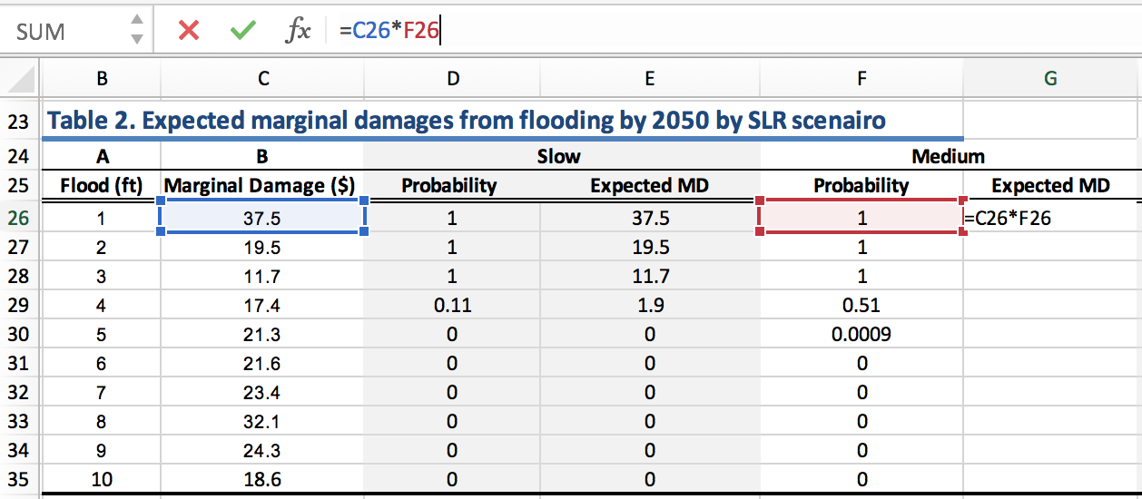
Part 1: Calculating Expected Damages from Flooding
In Table 2 in the Excel spreadsheet, the expected marginal damages for each flood level have been calculated for the slow sea level rise scenario for the year 2050. (Note that the marginal damages in column B are the same as the ones you calculated above in Table 1.)
1. Calculate the Expected MD for the Medium SLR scenario in Table 2. To do this, multiply the marginal damage of flooding (x_{F,1} ) by the probability of flooding (p_{F,1} ) for a max flood height of 1ft using the formula ‘=C26*F26’.
2. Drag down the formula to replicate it in the rest of the column.
3. Repeat this process for the High and Extreme scenarios to complete Table 2.
Pause for Analysis: Discuss with a partner what the value in cell E29 in Table 2 represents. Be as specific as possible.

Slide 9
Part 1: Calculating Expected Damages from Flooding
To fill out the rest of Table 3 you will need to get data on the probability of flooding at each water level for the year 2100 from the Riskfinder.org website.
Note: The setting should be for ’Multi-year risk of flooding’
1. On the Risk Finder website for your region select the ‘Medium’ Sea level scenario on the right side of the graph and the 4ft Water level on the left side. Hover over the year of interest on the bar chart (2060) to see that the probability of a flood of 4ft or more by 2060 is 92% (or 0.92).
2. Fill out Probability column in Table 3 for the medium rise scenario by finding the probabilities for each level of flooding for the year 2100.
3. Complete the rest of Table 3 by calculating the expected marginal damages for the medium, high, and extreme scenarios.

Slide 10
Part 2: Graphing Marginal Damage Curves
The tables are a helpful way to organize the data and do some basic calculations, but when presenting the data, graphs are a better way to convey a lot of information in one figure. In this section you will make graphs of the expected marginal damage curves you just calculated for each SLR scenario.
Click on the ‘MD graphs’ tab at the bottom of the Excel spreadsheet. Tables 4 and 5 show the expected marginal damages from flooding for each sea level rise scenario for the year 2050 (Table 4) and 2100 (Table 5).
The tables have automatically populated with the expected MD values you calculated on the previous spreadsheet.
If you click on a cell, you can see the reference cell it is drawing the data from in the formula bar (fx) at the top, where ‘MD Table’ is the sheet name you were previously working in and E26 is the cell on that sheet the data is copied from.
Now you will create a graph of the four sea level rise scenarios to show the marginal damages expected at each foot of flooding. A graph of Table 4 has already been made for you, in the next slide you will learn how to create the same graph for Table 5.

Slide 11
Part 2: Graphing Marginal Damage Curves
To make a graph in Excel:
1. Use the cursor and drag to highlight the contents of the Table as pictured.
2. Go to the Insert tab then click on the drop down options for scatter charts and select the option with smooth lines and markers.
Alternatively, you can click Insert at the top of the page, then Chart > Scatter > Smooth Marked Scatter
Congrats! You should now have a graph!
You can click on the graph and drag it to move it around on your spreadsheet. Note: The x-axis will be based on the far left-hand column units (feet of flooding) and the y-axis will be in millions of dollars. The legend is based on the column headings.

Slide 12
Part 2: Formatting Graphs in Excel
After you make your graph, you will want to add titles to the graph and the axes. If someone was to look at your graph out of context, they should be able to understand exactly what data is being displayed.
Formatting Graphs in Excel
1. To add a title, click anywhere on the graph and a ‘Chart Design’ tab appear at the top.
2. Click on on the ‘Chart Design’ tab and from there you should see a drop down for adding chart elements.
3. Add a main title to your graph and vertical and horizontal axis titles.
Pause for Analysis: Looking at the graphs, what is your hypothesis for why the highest marginal damages are from the first couple feet of flooding? Discuss with a partner or in a small group.

Slide 13
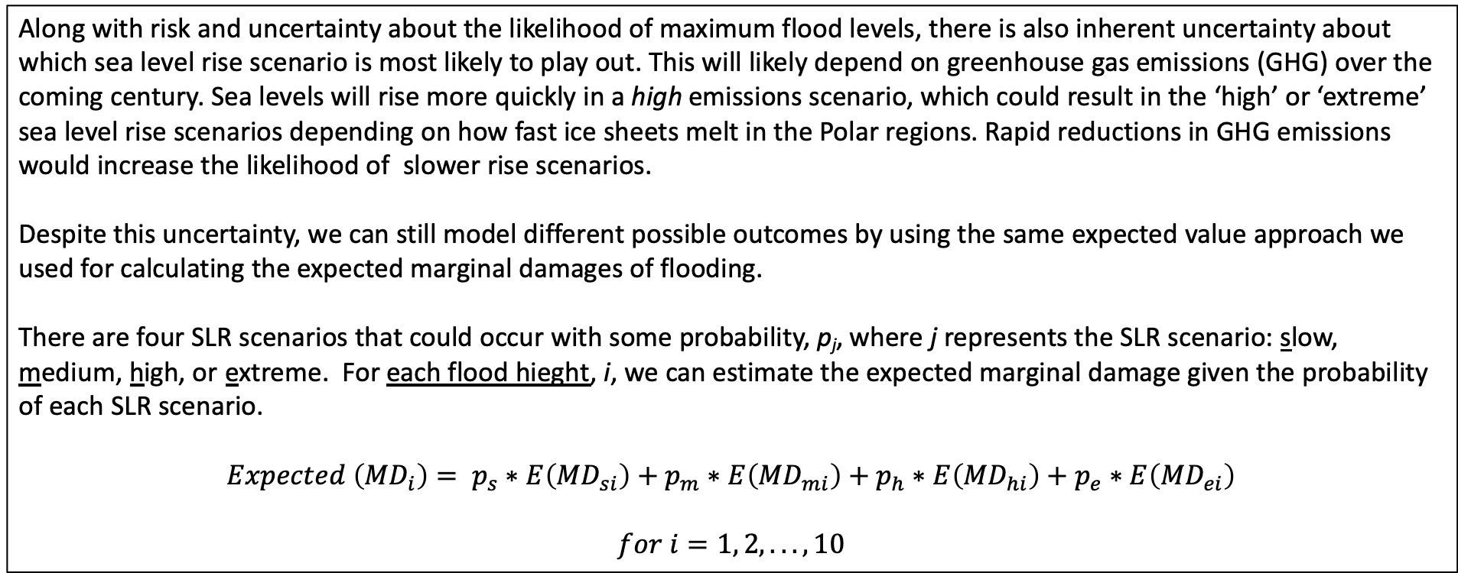
Part 3: Making Decisions Under Uncertainty
Along with risk and uncertainty about the likelihood of maximum flood levels, there is also inherent uncertainty about which sea level rise scenario is most likely to play out. This will likely depend on greenhouse gas emissions (GHG) over the coming century. Sea levels will rise more quickly in a high emissions scenario, which could result in the ‘high’ or ‘extreme’ sea level rise scenarios depending on how fast ice sheets melt in the Polar regions. Rapid reductions in GHG emissions would increase the likelihood of slower rise scenarios.
Despite this uncertainty, we can still model different possible outcomes by using the same expected value approach we used for calculating the expected marginal damages of flooding.
There are four SLR scenarios that could occur with some probability, p_{j}, where j represents the SLR scenario: slow, medium, high, or extreme. For each flood hieght, i, we can estimate the expected marginal damage given the probability of each SLR scenario.
$$Expected \left({MD}_{i}\right)= p_{s}∗E\left({MD}_{si}\right)+p_{m}∗E\left({MD}_{mi}\right)+p_{h}∗E\left({MD}_{hi}\right)+p_{e}∗E\left({MD}_{ei}\right)$$
$$for i=1, 2,... ,10$$

Slide 14
Part 3: Making Decisions Under Uncertainty
In this analysis we will refer to 3 different emissions scenarios modeled after the Intergovernmental Panel on Climate Change (IPCC) report on Representative Concentration Pathways (RCPs):
RCP 2.6 is the best case scenario which would result in the lowest sea level rise and associated warming of 0.5 to 2.8 °F by the year 2100.
RCP 4.5 is a moderate scenario where GHG emissions stabilize by 2100, which would result in approximately 2 to 4.6 °F or warming by the end of the century.
RCP 8.5 is the worst case scenario, which would result in the highest sea level rise and potentially the extreme scenario playing out with associated warming of 4.5 to 8.6 °F by 2100.
For more information on the RCPs, you can refer to the Summary for Policy Makers of the 5th Assessment Report.
Pause for Analysis: Consider the best case and worst case scenarios described above. In a small group or with a partner discuss what factors (economic, social, political, technological, etc.) would increase the probability of the best case scenario playing out? What factors would increase the probability of the worst case scenario playing out?

Slide 15
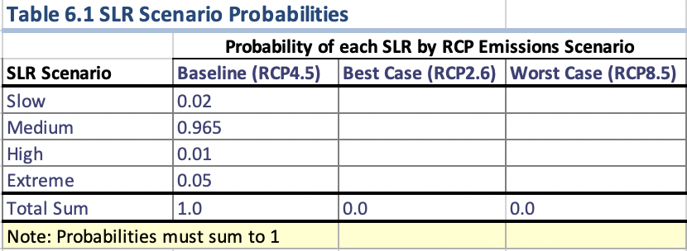
Part 3: Making Decisions Under Uncertainty
Now you will consider probabilities for different emissions scenarios and the subsequent sea level rise that would take place under each scenario using expected value calculations. Refer to Part 3. on the Excel spreadsheet on the ’Cost-Benefit Graph’ tab. Table 6 shows predicted probabilities of each SLR scenario occurring under the baseline scenario based on a 2017 NOAA report.
Considering your previous discussion on the best and worst case emissions scenarios, fill in probabilities for each scenario in Table 6. Note that the probabilities must sum to 1.
2. Notice that as you fill in the probabilities, Table 7 populates with the expected housing damages for each foot of flooding for the respective emissions scenarios, along with the graph in Figure 3.
3.

Slide 16
Part 3: Making Decisions Under Uncertainty
Now you will consider probabilities for different emissions scenarios and the subsequent sea level rise that would take place under each scenario using expected value calculations. Refer to Part 3. on the Excel spreadsheet on the ’Cost-Benefit Graph’ tab. Table 6 shows predicted probabilities of each SLR scenario occurring under the baseline scenario based on a 2017 NOAA report.
1. Considering your previous discussion on the best and worst case emissions scenarios, fill in probabilities for each scenario in Table 6. Note that the probabilities must sum to 1.
2. Notice that as you fill in the probabilities, Table 7 populates with the expected housing damages for each foot of flooding for the respective emissions scenarios, along with the graph in Figure 3.
3.

Slide 17
Post-Module Memo Assignment

